Slide 1
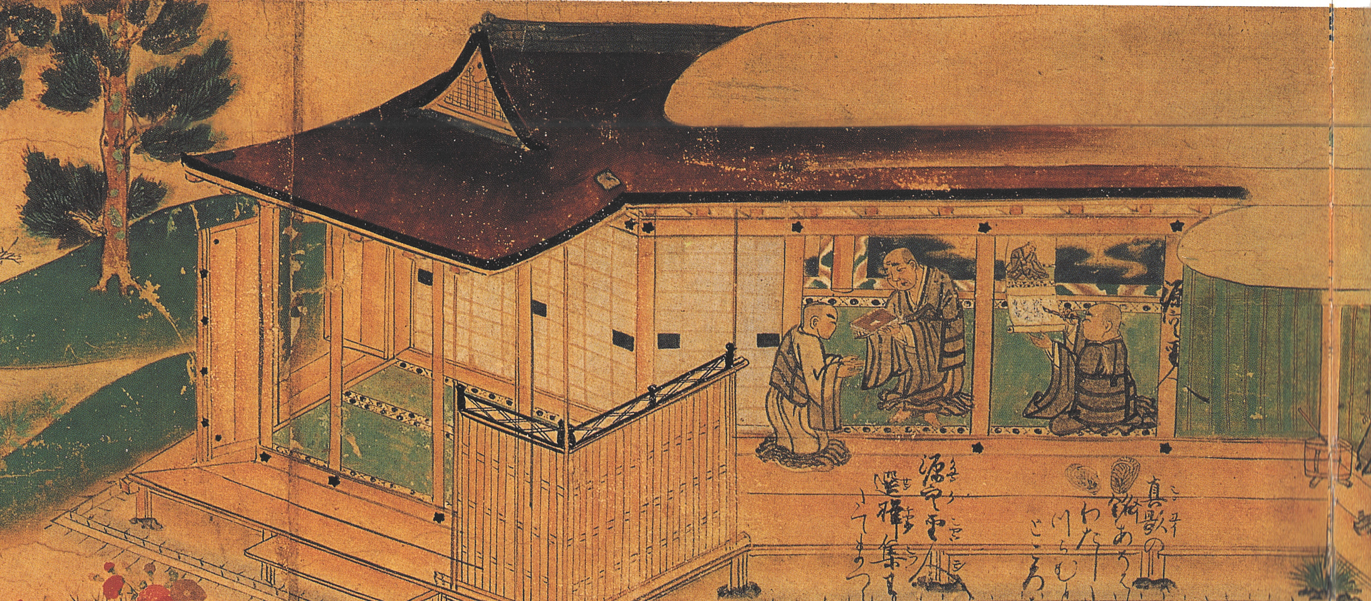
EALC FALL 2018 SPEAKER SERIES
Christopher Callahan
Lecturer, East Asian Languages and Cultures
"Performing Pictures: Etoki and the Illustrated Biography of Shinran"
Friday, October 12, 4:00PM, Lucy Ellis Lounge,
1080 Foreign Languages Building, 707 S. Mathews Ave, Urbana, IL
Etoki, the practice of the elucidation of and by images, was utilized by Buddhist preachers and popular storytellers to entertain audiences and propagate Buddhism. Many scholars, such as Hayashi Masahiko and Kaminishi Ikumi have analyzed the multifaceted culture of etoki and taken note of the role that etoki storytelling played in the popularization of Buddhism in Japan. Although much of this scholarship has assumed that etoki story-tellers used a wide variety of formats, such as wall paintings, hanging scrolls and illustrated hand-scrolls, there are a number of unanswered questions regarding the use of hand-scrolls (emaki) in etoki performances. Looking closely at one illustrated hand-scroll of the Life of Shinran by Kakunyo (1270-1351), I will attempt to reconstruct the historical context of the scroll’s production, the ritual context for its use and viewing and the performative dimensions of the scroll itself in order to answer some of these questions.
For information about our series:
https://ealc.illinois.edu/research/ealc-speaker-series

